Slide 1
ECOVISION
October 2020
Prishtine, Kosova
NASA Spaceapps challenge 2020
A ONE HEALTH APPROACH
Getuar Kelmendi
Lorena Mekaj
Roni Kukaj
Zgjim Zhubaj

Slide 2
Presentation
Outline
A One Health Approach
Air pollution
Case studies – Germany & Sweden
Conclusion

Slide 3
Finding a correlation between public health, air pollution, and COVID-19
Effects of COVID-19 on air quality
Using different datasets
A One Health Approach
01

Slide 4
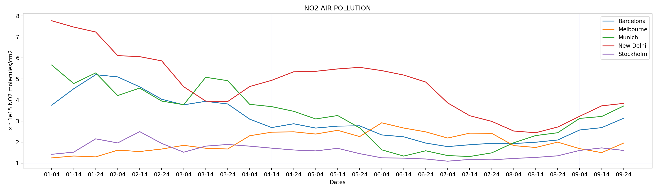
Air pollution
Biggest air pollutants: NO₂, CO, SO₂ …
A decrease in the presence of NO₂ in some of the big cities
Difference between these cities

Slide 5
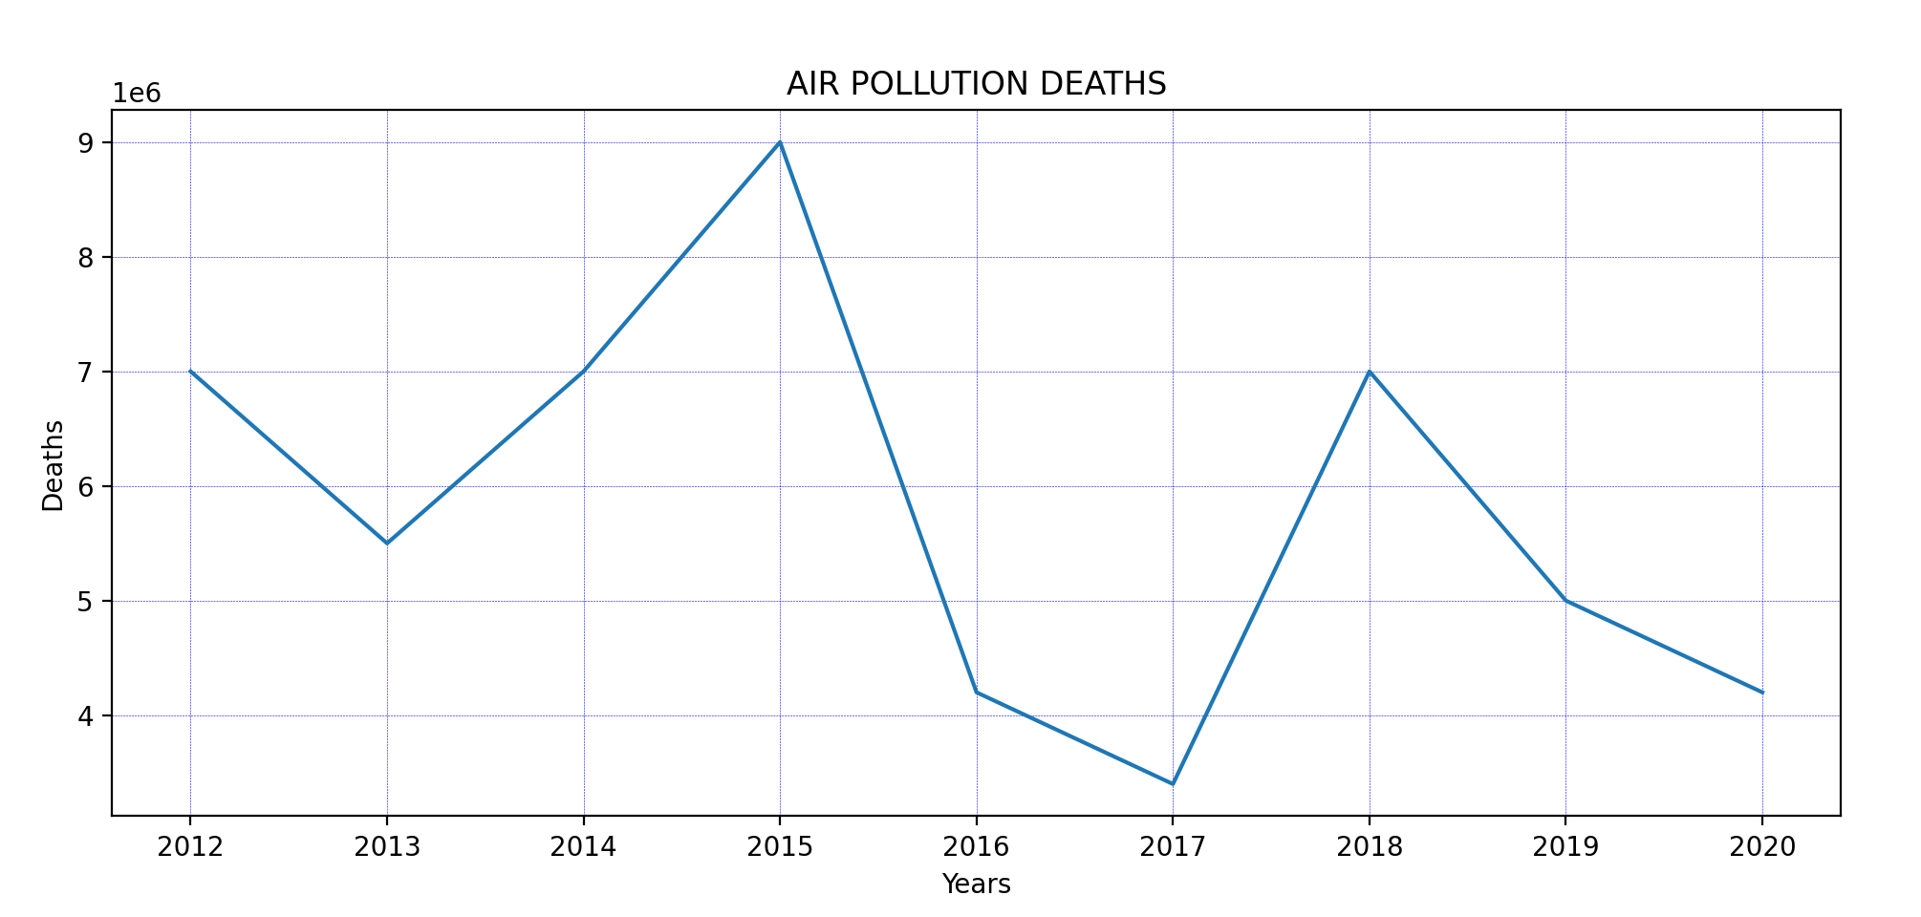
Deaths because of air pollution

Slide 6
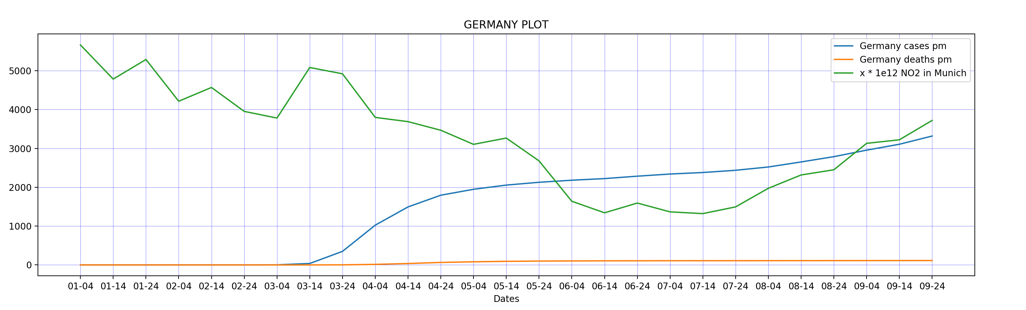
Case study - Germany

Slide 7
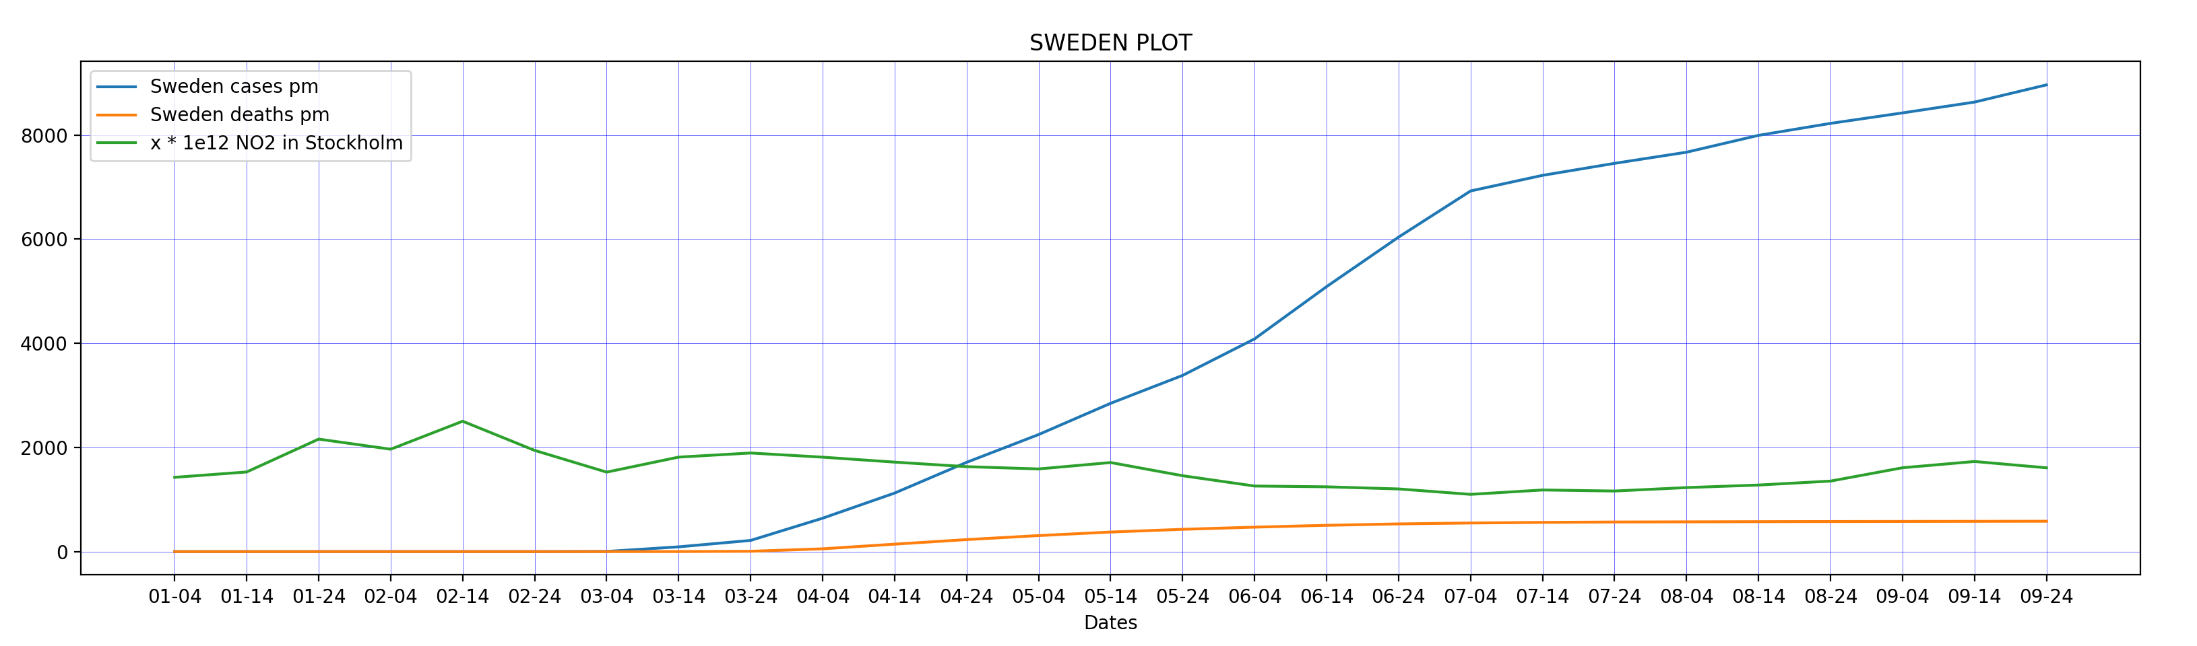
Case study - Sweden

Slide 8
Conclusion
COVID-19 people staying home better air quality less deaths
Less outdoor pollution more indoor pollution
How can this help us study air effects on public health?

Slide 9
THANK YOU

